Slide 1

Forecasting Students’ Exam Results Based on Online Activity and Self-Reported Self Regulation A Partially Interpretable Machine Learning Approach
Filotas Theodosiou, Yves R. Sagaert, Liam Bossant, Tom Madou
VIVES University of Applied Sciences
Notes:
Abstract: Collaboration in the supply chain between a retailer and a supplier has been extensively researched. Much of the relevant literature has focused on the theoretical impact of this collaboration, with several studies arguing for its potential benefits, ranging from counteracting the bullwhip effect to reducing the likelihood of a stock-out. Despite this, most empirical work has focused on improving the accuracy of supplier-level forecasting. Using regression-based approaches, retailer sales information is included as exogenous variables to improve the supplier demand forecasts. However, this has limited benefits for the retailer. In this work, we aim to reduce total supply chain costs, both at the retailer and supplier level, by tracking decisions throughout the supply chain. These decisions are usually made on different frequencies. Our case study consists of a supply chain with three echelons: shop level, distribution centre (DC) and supplier level. The decisions about replenishing inventory are made at different times for each tier, causing the decision makers to model demand at different frequencies. Driven by the advances in the hierarchical forecasting literature, we propose ordering the demand time series into temporal and cross-sectional aggregations and structure them into a partial cross-temporal hierarchy. The decisions are not taken at the same moment across supply chain echelons but usually in a reactive manner that is prone to overstocking. The hierarchical approach allows to represent the propagation of decision-making, enhancing the potential for collaboration. This creates the potential for an AI-driven integrated supply chain. We examine how this hierarchical approach enables information sharing across decision levels and data frequencies and its impact on the total supply chain. We present the results based on data from a logistics network with 275 stores, 4 distribution centres and one supplier.

Slide 2
Forecasting students exams results based on online activity and self reported self regulation
Filotas Theodosiou
Presentation Outline
Introduction
Data
Problem Framing & Model Fitting
Uncertainty Estimation
Explainability
Conclusion
1
2
3
4
5
ISF 2022
6
1

Slide 3
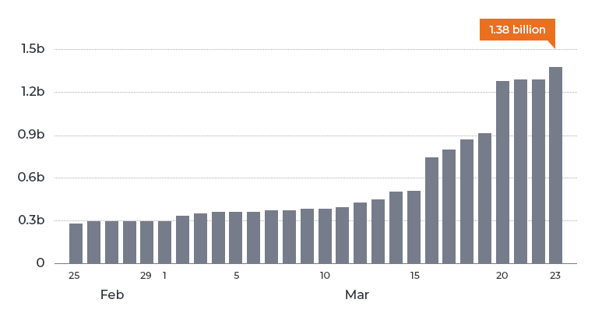
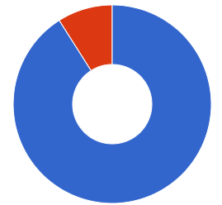

Introduction to Learning Analytics
Forecasting students exams results based on online activity and self reported self regulation
Filotas Theodosiou
In a Nutshell
Total Students Impacted By Covid - 19
Virtual Classes:
Created Learning Opportunities
Affect Teacher - Student interactions
91% of students switched to online education
A novel education paradigm:
The Difficulties.
Exacerbated learning inequities
Its effectiveness is questioned
Novel challenges for teachers
Trouble in monitoring performances
A field on the rise.
Learning Analytics:
Not a new Field
What is the field about?
Measure - Collect - Analyze Students Data
What is purpose of the field?
Optimize learning environments
A Novel Education Paradigm:
The Explosion of Data.
History tells us:
Understand situations better
Predict future with higher accuracy
ISF 2022
2
Wise, A.F., Knight, S., Ochoa, X., 2021. What Makes Learning Analytics Research Matter. Journal of Learning Analytics 8, 1–9. https://doi.org/10.18608/jla.2021.7647

Slide 4
Current Literature Status on Learning Analytics
Forecasting students exams results based on online activity and self reported self regulation
Filotas Theodosiou
Benefits, Commonly Applied Methods and Literature Gaps
Identified Benefits of LA
Reduce dropout rate
Assist in Curricula Design
Create a more personalized learning environment
Accurate predictions of student performance
When paired with external data
Descriptive Learning Analytics
Understand Students
Predictive Learning Analytics
Forecast their performance
Identified Literate Gaps:
Accuracy over Early Predictions
Forecasting late leaves no time for adjustments
Do Teachers Have Confidence in Complex Models?
Lack the specialized skills for interpretations
Rely on their intuition
Limited faith in explained predictions of complex models
Use more Complex models to deal with data shortage
ISF 2022
3
Cui, Y., Chen, F., Shiri, A.,& Fan, Y. (2019). Predictive analytic models of student success in higher education: A review of methodology. Information and Learning Sciences,120(3/4), 208–227. http://dx.doi.org/10.1108/ILS-10-2018-0104

Slide 5
An Interpretable Decision Support Framework
Forecasting students exams results based on online activity and self reported self regulation
Filotas Theodosiou
Forecast to Assist Teachers Decisions
The Objective of this Work:
A Predictive Decision Support System.
Early Enough time to adjust and personalize teaching strategy
Accurate Have a good view on the future performance
Transparent Add explanations to gain confidence and trust
The Aim of this work:
Assist Students with Improvement Goals and Enough Adjustment Time
Early Identification of students at risk
Personalized explanations/suggestions
Deal with Uncertainty
Driven By Literature: We Combine:
Students Online Activity Data
Self Reported Data for Learning Strategies
A questionnaire for self-regulation
ISF 2022
4

Slide 6
Presentation Outline
Forecasting students exams results based on online activity and self reported self regulation
Filotas Theodosiou
Introduction
Data
Problem Framing & Model Fitting
Uncertainty Estimation
Explainability
Conclusion
1
2
3
4
5
ISF 2022
6
5

Slide 7
Collecting Students Online Activity Data
Forecasting students exams results based on online activity and self reported self regulation
Filotas Theodosiou
Moodle: A Learning Management System
We use Moodle an Online Learning Platform
We consider a single first year course
Data collected on the first semester of 2 years
Only collect students information with ethical consent
ISF 2022
6

Slide 8
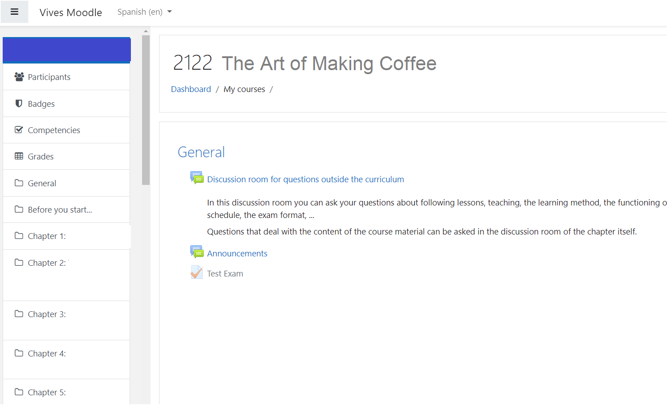
Collecting Students Online Activity Data
Forecasting students exams results based on online activity and self reported self regulation
Filotas Theodosiou
Moodle: A Learning Management System
We use Moodle an Online Learning Platform
We consider a single first year course
Data collected on the first semester of 2 years
Only collect students information with ethical consent
ISF 2022
6

Slide 9
Collecting Students Online Activity Data
Forecasting students exams results based on online activity and self reported self regulation
Filotas Theodosiou
Moodle: A Learning Management System
We use Moodle an Online Learning Platform
We consider a single first year course
Data collected on the first semester of 2 years
Only collect students information with ethical consent
Collected Data Includes:
ISF 2022
6

Slide 10
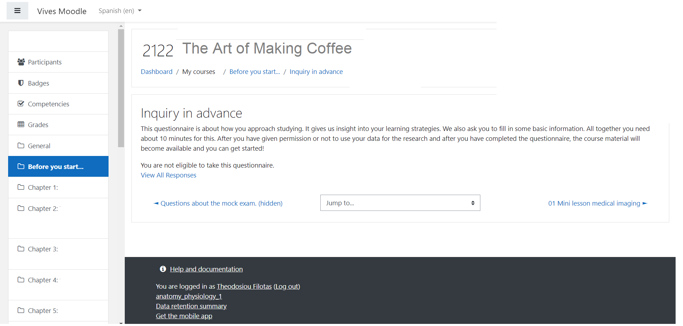
Collecting Students Online Activity Data
Forecasting students exams results based on online activity and self reported self regulation
Filotas Theodosiou
Moodle: A Learning Management System
We use Moodle an Online Learning Platform
We consider a single first year course
Data collected on the first semester of 2 years
Only collect students information with ethical consent
Collected Data Includes:
MSLQ: A questionnaire about self-regulations and learning strategies
ISF 2022
6

Slide 11
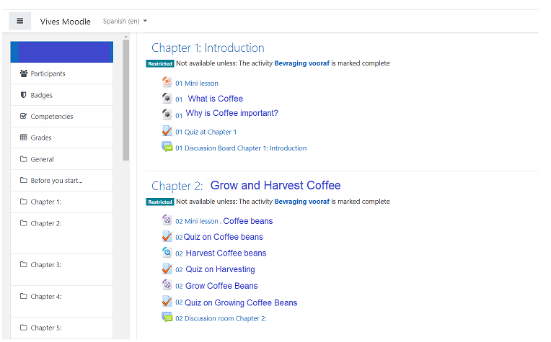
Collecting Students Online Activity Data
Forecasting students exams results based on online activity and self reported self regulation
Filotas Theodosiou
Moodle: A Learning Management System
We use Moodle an Online Learning Platform
We consider a single first year course
Data collected on the first semester of 2 years
Only collect students information with ethical consent
Collected Data Includes:
MSLQ: A questionnaire about self-regulations and learning strategies
ISF 2022
6

Slide 12
Collecting Students Online Activity Data
Forecasting students exams results based on online activity and self reported self regulation
Filotas Theodosiou
Moodle: A Learning Management System
We use Moodle an Online Learning Platform
We consider a single first year course
Data collected on the first semester of 2 years
Only collect students information with ethical consent
Collected Data Includes:
MSLQ: A questionnaire about self-regulations and learning strategies
Material Accessed: Text and Videos
ISF 2022
6

Slide 13
Collecting Students Online Activity Data
Forecasting students exams results based on online activity and self reported self regulation
Filotas Theodosiou
Moodle: A Learning Management System
We use Moodle an Online Learning Platform
We consider a single first year course
Data collected on the first semester of 2 years
Only collect students information with ethical consent
Collected Data Includes:
MSLQ: A questionnaire about self-regulations and learning strategies
Material Accessed: Text and Videos
Quiz: Questions on Material viewed
ISF 2022
6

Slide 14
Collecting Students Online Activity Data
Forecasting students exams results based on online activity and self reported self regulation
Filotas Theodosiou
Moodle: A Learning Management System
We use Moodle an Online Learning Platform
We consider a single first year course
Data collected on the first semester of 2 years
Only collect students information with ethical consent
Collected Data Includes:
MSLQ: A questionnaire about self-regulations and learning strategies
Material Accessed: Text and Videos
Quiz: Questions on Material viewed
Forums: Discussion Board
ISF 2022
6

Slide 15
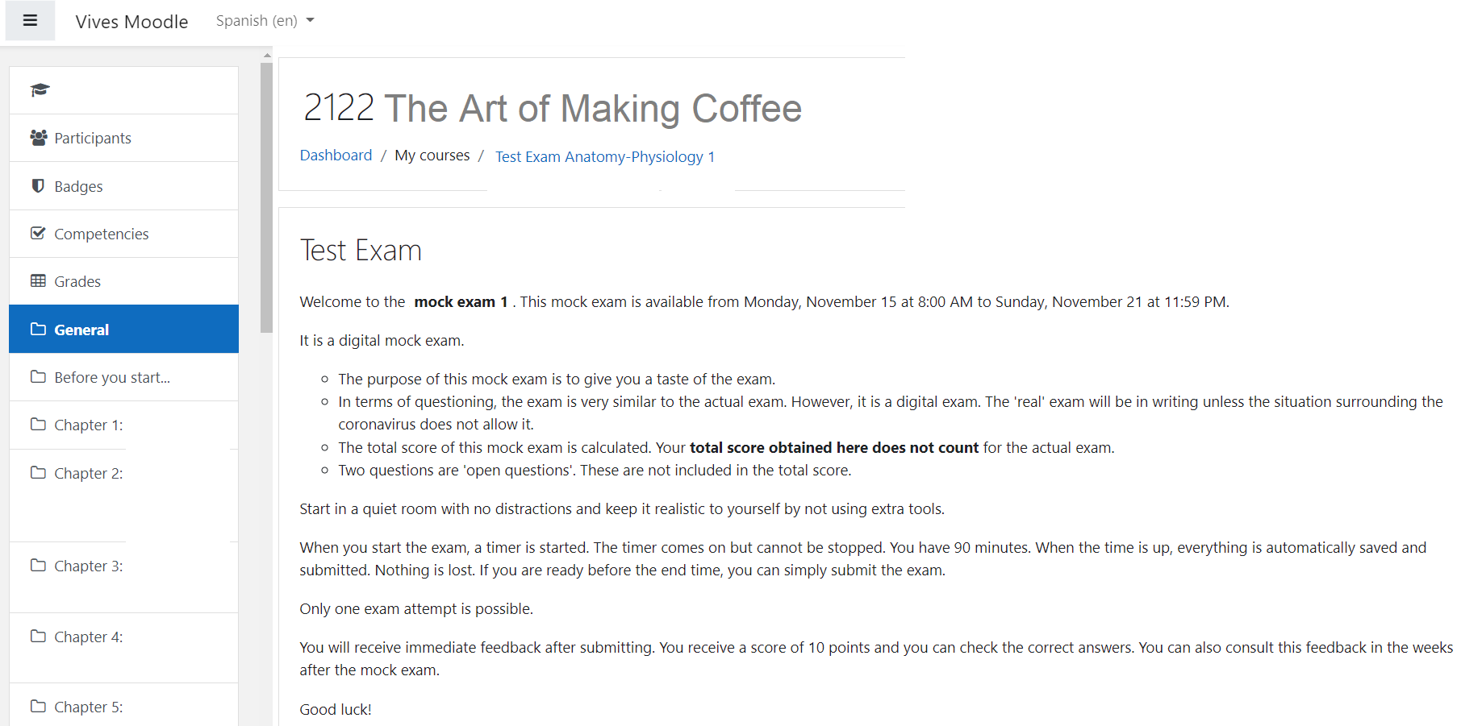
Collecting Students Online Activity Data
Forecasting students exams results based on online activity and self reported self regulation
Filotas Theodosiou
Moodle: A Learning Management System
We use Moodle an Online Learning Platform
We consider a single first year course
Data collected on the first semester of 2 years
Only collect students information with ethical consent
Collected Data Includes:
MSLQ: A questionnaire about self-regulations and learning strategies
Material Accessed: Text and Videos
Quiz: Questions on Material viewed
Forums: Discussion Board
Trial Exam: An Exam Mimicking the Original Exam
ISF 2022
6

Slide 16
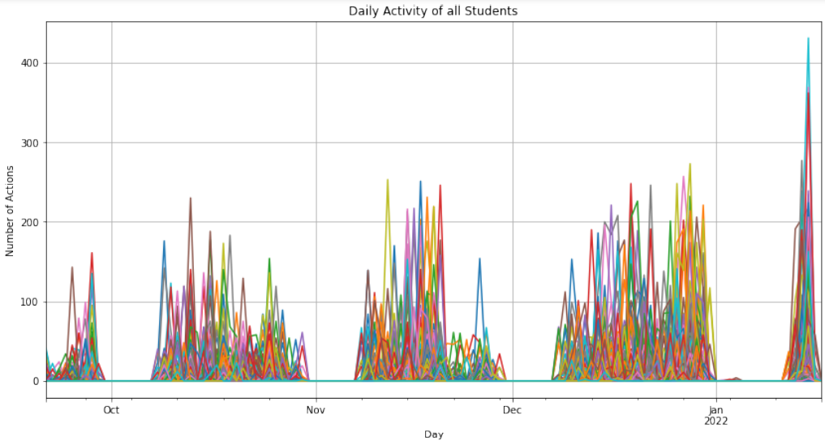
Pick the Forecasting Day
Forecasting students exams results based on online activity and self reported self regulation
Filotas Theodosiou
Aim for Early Identification.
ISF 2022
7

Slide 17
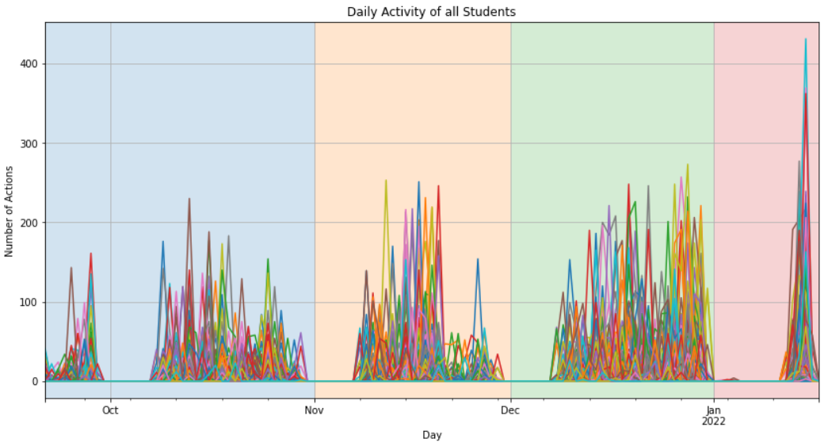
Pick the Forecasting Day
Forecasting students exams results based on online activity and self reported self regulation
Filotas Theodosiou
Aim for Early Identification.
ISF 2022
7

Slide 18
Pick the Forecasting Day
Forecasting students exams results based on online activity and self reported self regulation
Filotas Theodosiou
Aim for Early Identification.
Early Semester
Mid Semester
Late Semester
Exam
Period
ISF 2022
7

Slide 19
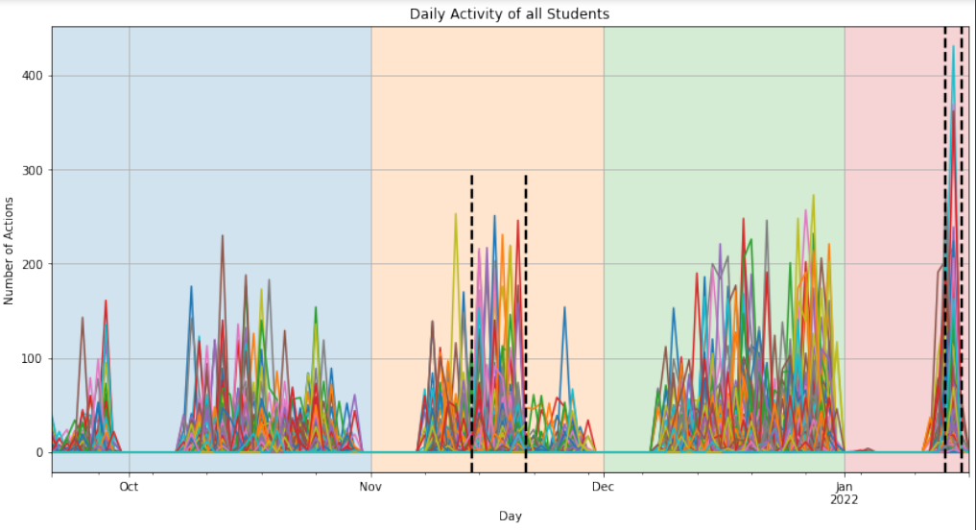
Pick the Forecasting Day
Forecasting students exams results based on online activity and self reported self regulation
Filotas Theodosiou
Aim for Early Identification.
Weekend
before the exams
Early Semester
Mid Semester
Late Semester
Exam
Period
ISF 2022
Trial exam is online
7

Slide 20
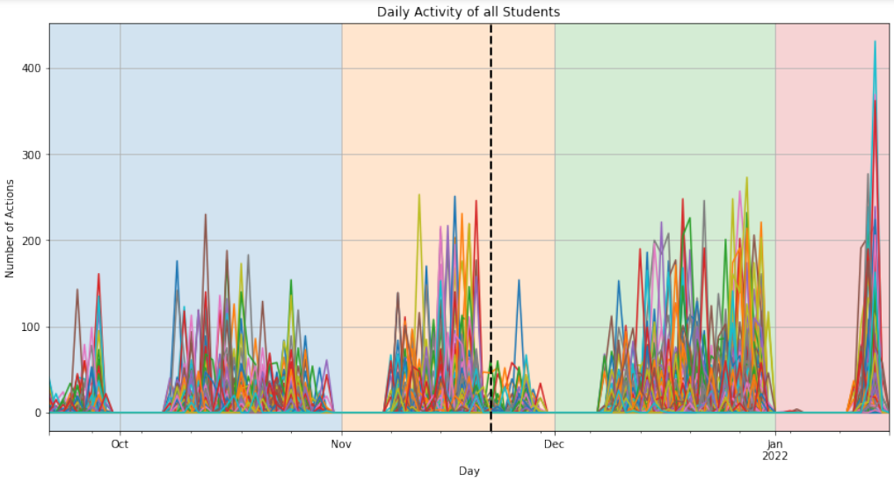
Pick the Forecasting Day
Forecasting students exams results based on online activity and self reported self regulation
Filotas Theodosiou
Aim for Early Identification.
Hypothesis: Forecasting in the middle of semester is “sweat point”
Trial Exam results
ISF 2022
7

Slide 21
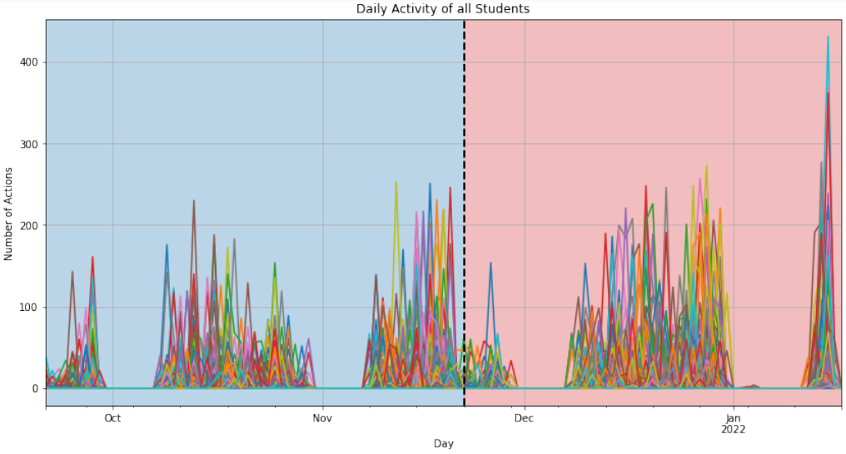
Pick the Forecasting Day
Forecasting students exams results based on online activity and self reported self regulation
Filotas Theodosiou
Aim for Early Identification.
Hypothesis: Forecasting in the middle of semester is “sweat point”
Trial Exam results
Activity data from 55 days.
A total of 61 days for learning adjustments (find number of days)
ISF 2022
7

Slide 22
Pick the Forecasting Day
Forecasting students exams results based on online activity and self reported self regulation
Filotas Theodosiou
Aim for Early Identification.
Hypothesis: Forecasting in the middle of semester is “sweat point”
Trial Exam results
Activity data from 55 days.
A total of 61 days for learning adjustments (find number of days)
Strategy Adjustment
Data Collection
ISF 2022
7

Slide 23
Presentation Outline
Forecasting students exams results based on online activity and self reported self regulation
Filotas Theodosiou
Introduction
Data
Problem Framing & Model Fitting
Uncertainty Estimation
Explainability
Conclusion
1
2
3
4
5
ISF 2022
6
8

Slide 24
Problem Framing
Forecasting students exams results based on online activity and self reported self regulation
Filotas Theodosiou
What Should I Forecast?
Class 0: Students Scoring < 8
A total of 273 students
Do all students require the same teaching behavior?
Class 1: Students Scoring > 8 and < 13
Class 2: Students Scoring > 13
ISF 2022
9

Slide 25
Problem Framing
Forecasting students exams results based on online activity and self reported self regulation
Filotas Theodosiou
What Should I Forecast?
Class 0: Students Scoring < 8
A total of 273 students
Do all students require the same teaching behavior?
Class 1: Students Scoring > 8 and < 13
Class 2: Students Scoring > 13
We are interested in Class 1: The “Borderliners”
Students at risk & students requiring some nudging to pass the course
Fitting Objective: Classification vs Regression
ISF 2022
9

Slide 26
Problem Framing
Forecasting students exams results based on online activity and self reported self regulation
Filotas Theodosiou
What Should I Forecast?
Class 0: Students Scoring < 8
A total of 273 students
Do all students require the same teaching behavior?
Class 1: Students Scoring > 8 and < 13
Class 2: Students Scoring > 13
We are interested in Class 1: The “Borderliners”
Students at risk & students requiring some nudging to pass the course
Fitting Objective: Classification vs Regression
Better view on models performance
Easier uncertainty quantification
ISF 2022
Performance Evaluation: Classification vs Regression
9

Slide 27
Problem Framing
Forecasting students exams results based on online activity and self reported self regulation
Filotas Theodosiou
What Should I Forecast?
Class 0: Students Scoring < 8
A total of 273 students
Do all students require the same teaching behavior?
Class 1: Students Scoring > 8 and < 13
Class 2: Students Scoring > 13
We are interested in Class 1: The “Borderliners”
Students at risk & students requiring some nudging to pass the course
Fitting Objective: Classification vs Regression
Better view on models performance
Easier uncertainty quantification
ISF 2022
Performance Evaluation: Classification vs Regression
Our aim is to identify the students at risk
An “easier” task
Not so interested in the actual grades
9

Slide 28
Problem Framing
Forecasting students exams results based on online activity and self reported self regulation
Filotas Theodosiou
What Should I Forecast?
Class 0: Students Scoring < 8
A total of 273 students
Do all students require the same teaching behavior?
Class 1: Students Scoring > 8 and < 13
Class 2: Students Scoring > 13
We are interested in Class 1: The “Borderliners”
Students at risk & students requiring some nudging to pass the course
Evaluation Strategy
We Use Recall on Class 1
Proportion of actual borderlines identified
We also consider Accuracy and MSE
For further performance comparisons
We use an 8-fold Cross Validation
Every student is added on a test set
Fitting Objective: Classification vs Regression
Better view on models performance
Easier uncertainty quantification
ISF 2022
Performance Evaluation: Classification vs Regression
Our aim is to identify the students at risk
An “easier” task
Not so interested in the actual grades
9

Slide 29
Model Selection
Forecasting students exams results based on online activity and self reported self regulation
Filotas Theodosiou
Trees, Trees Everywhere!
Gradient Boosted Decision Trees (GBDT)
XGBoost
CatBoost
LightGBM
Preferred over Complex
Deep Learning Methods
(on Tabular Data)
Additional Benefits:
Handle missing values Students skip some modules
Penalize non-important features Allowing for an increased number of predictors
Compatibility with explainability techniques XAI methods optimized for GBDT methods
ISF 2022
Lets Talk Strategy:
Step 1: Train a Model on Regression Task
Step 2: Bin Predictions to Classes
Step 3: Get an Explanation for Each Predictions
Attention:
The performance of GBDT models is highly correlated with the quality of the predictors
10
Shwartz-Ziv, R., Armon, A., 2021. Tabular Data: Deep Learning is Not All You Need.
Fayaz, S.A., Zaman, M., Kaul, S., Butt, M.A., 2022. Is Deep Learning on Tabular Data Enough? An Assessment. International Journal of Advanced Computer Science and Applications (IJACSA) 13. https://doi.org/10.14569/IJACSA.2022.0130454

Slide 30
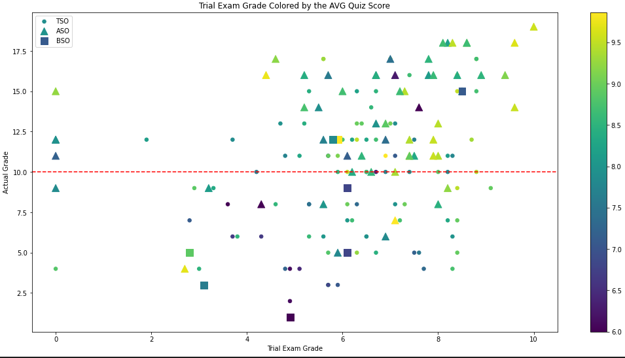
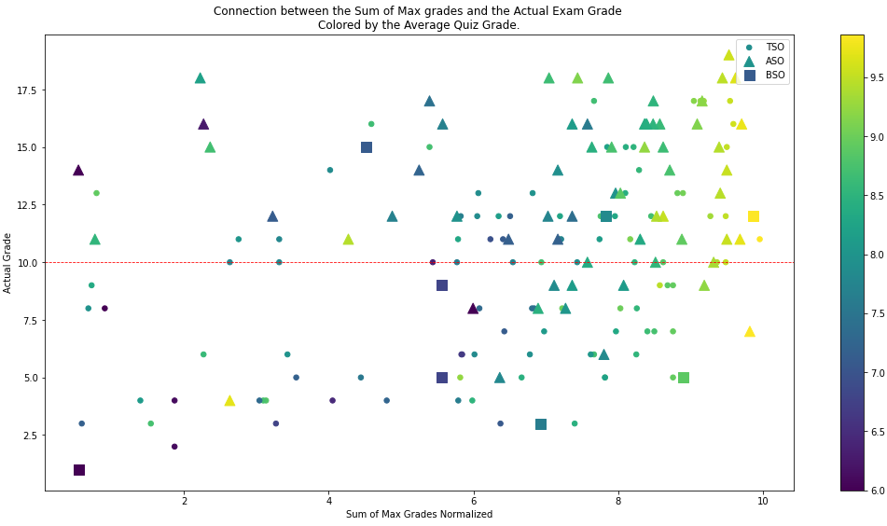
Feature Engineering
Forecasting students exams results based on online activity and self reported self regulation
Filotas Theodosiou
Thinking Like a Teacher
“Good Features” Serve Two Purposes
Boost Accuracy
Generate Better Explanations
Key Questions:
How does a teacher look for at a student?
How to translate these into meaningful features?
Starting Categories
MSLQ
Material Accessed
Quiz
Forums
Trial Exam
Basic Predictors
…
Avg
Variance
Min/Max
Totals
More Advanced (combinations)
(e.g. Sum of Max Grades)
ISF 2022
11
Check appendix for a full description of features

Slide 31
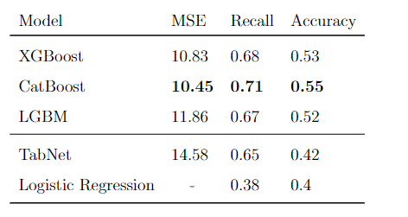
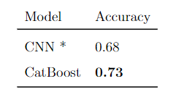
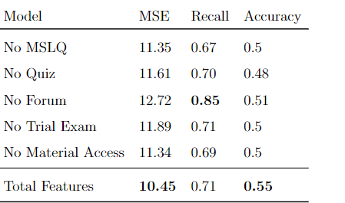
Model Selection & Evaluation
Forecasting students exams results based on online activity and self reported self regulation
Filotas Theodosiou
Select the Final Forecasting Model
Select the Forecasting Model
GBDTs outperform Benchmarks
CatBoost outperforms other GBDTs
Catboost is picked as the forecasting model
Compare with CNN Model (Sagaert et al, 2022)
Pass/Fail Accuracy Comparison
CatBoost fitted on mid-semester, CNN on full semester
ISF 2022
Evaluate Feature Selection
Each set contributes to the models performance
12

Slide 32
Presentation Outline
Forecasting students exams results based on online activity and self reported self regulation
Filotas Theodosiou
Introduction
Data
Problem Framing & Model Fitting
Uncertainty Estimation
Explainability
Conclusion
1
2
3
4
5
ISF 2022
6
13

Slide 33
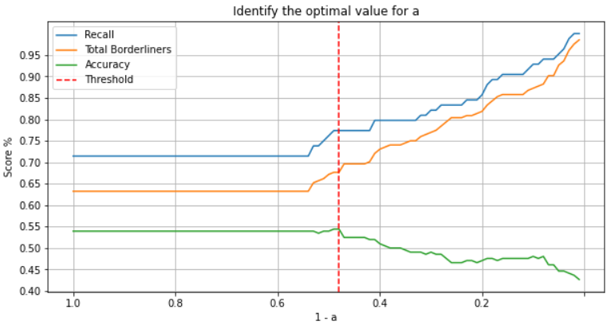
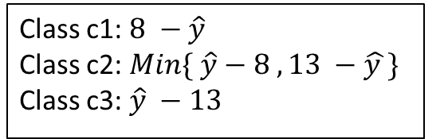
Uncertainty Estimation
Forecasting students exams results based on online activity and self reported self regulation
Filotas Theodosiou
Increase Confidence Through Conformal
Predictions
Softmax Score σ(c1):
A heuristic notion of uncertainty
(Confidence in Predictions)
Confidence in classification: Increase the trust of teachers into models predictions
Calculate a score for each class distance from class interval
Get softmax scores: σ(c1), σ(c2), σ(c3)
Class c1: $8 −\hat{y}$
Class c2: $\operatorname{Min}{\{ \hat{y}}−8 , 13 −\hat{y }\}$
Class c3: $\hat{y} −13$
Uncertainty Estimation: Conformal Predictions (aka Empirical methods)
Focus on students classified with low confidence (increase recall)
Avoid overpopulating the borderliners class
Main Idea: Make adjustments through a holdout set
Step 1: Conformal score on holdout : (1 - σ(True Class))
Step 2: Get the 1 - a quantile: At least (1-a)% values above 1 - q
Step 3: Pick students with σ(c2) > 1 - q
Include low confidence predictions around 8 - ε , 12 + ε
Threshold
Almost 8/10
students at risk identified in time
large ε
Overpopulation
ISF 2022
small ε
No extra students
14

Slide 34
Presentation Outline
Forecasting students exams results based on online activity and self reported self regulation
Filotas Theodosiou
Introduction
Data
Problem Framing & Model Fitting
Uncertainty Estimation
Explainability
Conclusion
1
2
3
4
5
ISF 2022
6
15

Slide 35


Generate Explanations for Predictions
Forecasting students exams results based on online activity and self reported self regulation
Filotas Theodosiou
SHAP Values
SHapley Additive exPlanations (SHAP) values.
Quantify the contribution of each feature to a prediction
Inspired by game theory
Consider collaborations among features
A weighted sum of the marginal contributions of each feature to a local prediction
Marginal contributions for feature f
with P(S) the powerset of features
ISF 2022
Preferred over other approaches (like LIME)
Higher compatibility with GBDT methods
No linearity assumptions
Mathematical guarantees for fair distribution of contributions.
16
Lundberg, S.M., Lee, S.-I., 2017. A Unified Approach to Interpreting Model Predictions, in: Advances in Neural Information Processing Systems. Curran Associates, Inc.
He, J., Mazumdar, S., 2021. Comparing LIME and SHAP using Synthetic Polygonal Data Clusters. IJI 14, 2059–2067. https://doi.org/10.20533/iji.1742.4712.2021.0214

Slide 36
Predictions & Explanations Interpretations
Forecasting students exams results based on online activity and self reported self regulation
Filotas Theodosiou
Examples on Explanations – Suggestions Generations
Student A:
Predictions: 11.9 | Confidence = 51%
High Variance on Quiz Grades
Low Sum of Max Grades on Quizzes
Potential Suggestion: Repeat quizzes until you get achieve high grades everywhere
Student B:
Predictions: 9.35 | Confidence = 82%
Bad Scores on Trial Exam
Low Minimum Score on a Quiz
ISF 2022
Potential Suggestion: Repeat the trial exam and try harder. Also aim for higher quiz grades
Student C:
Predictions: 10.69 | Confidence = 67%
Low Forum Activity
17
Potential Suggestion: Be more active on forums. Read comments and write questions.

Slide 37
Presentation Outline
Forecasting students exams results based on online activity and self reported self regulation
Filotas Theodosiou
Introduction
Data
Problem Framing & Model Fitting
Uncertainty Estimation
Explainability
Conclusion
1
2
3
4
5
ISF 2022
6
18

Slide 38
Conclusion
Forecasting students exams results based on online activity and self reported self regulation
Filotas Theodosiou
Summary – Contributions – Future Work
Summary:
Early identification of students at risk for strategy adjustment
We propose an Interpretable Decision Support Framework for LMS
Early Forecasts.
Accurate Forecast.
Transparent Forecasts.
Halfway through the semester
78% Recall outperforms benchmarks & other methods
Accompany forecasts with confidence & explanations
Contributions:
A simple teacher-friendly framework.
Early explainable predictions considering the inherited uncertainty
Explanations for the predictions of every student used as suggestions for improvement
ISF 2022
Future work for next semester
Real - world test of the Decision Support Framework
Ethical considerations
19

Slide 39
Thank you for your attention ☺ Questions?
Filotas Theodosiou, Yves R. Sagaert, Liam Bossant, Tom Madou
VIVES University of Applied Sciences
Filotas.theodosiou@vives.be
www.linkedin.com/in/filotas-theodosiou/
Notes:
Abstract: Collaboration in the supply chain between a retailer and a supplier has been extensively researched. Much of the relevant literature has focused on the theoretical impact of this collaboration, with several studies arguing for its potential benefits, ranging from counteracting the bullwhip effect to reducing the likelihood of a stock-out. Despite this, most empirical work has focused on improving the accuracy of supplier-level forecasting. Using regression-based approaches, retailer sales information is included as exogenous variables to improve the supplier demand forecasts. However, this has limited benefits for the retailer. In this work, we aim to reduce total supply chain costs, both at the retailer and supplier level, by tracking decisions throughout the supply chain. These decisions are usually made on different frequencies. Our case study consists of a supply chain with three echelons: shop level, distribution centre (DC) and supplier level. The decisions about replenishing inventory are made at different times for each tier, causing the decision makers to model demand at different frequencies. Driven by the advances in the hierarchical forecasting literature, we propose ordering the demand time series into temporal and cross-sectional aggregations and structure them into a partial cross-temporal hierarchy. The decisions are not taken at the same moment across supply chain echelons but usually in a reactive manner that is prone to overstocking. The hierarchical approach allows to represent the propagation of decision-making, enhancing the potential for collaboration. This creates the potential for an AI-driven integrated supply chain. We examine how this hierarchical approach enables information sharing across decision levels and data frequencies and its impact on the total supply chain. We present the results based on data from a logistics network with 275 stores, 4 distribution centres and one supplier.

